Slide 1





CMP656
Bystander Privacy Protection in Smart Homes
A Mobile PWA for Privacy Negotiation in the Modern Smart Home
Hasan Malkoç
Gizem Aleyna Tuzcu
Notes:
hello, today we are discussing the paper titled «Bystander Privacy Protection in Smart Homes». We took academic researche and transformed it to a functional mobile progressive web app to negotiate privacy in the modern smart homes.

Slide 2
Problem Statement
01
02
General Surveillance: Smart homes utilize cameras, microphones, and sensors that often monitor bystanders without consent
Power Imbalance: Households (owners) hold the "privilege" of data collection, leaving guests and workers with no control.
04
03
Social Friction: Privacy concerns can prevent visits or strain relationships due to a perceived lack of trust.
Technical Barriers: Existing privacy tools require router access or technical expertise, which are inaccessible to most bystanders.
Notes:
the core issue we are investigating is a fundemental power imbalance. Currently, smart homes utilize cameras and microphones that often monitör bystanders without their explicit consent. Bystanders are like guests or workers in this context. There are four main parts of this problem.
General Survelliance: Constant monitoring is default behaviour in here.
Power Imbalance: Homeowners hold the privilege of data collection and leaves zero control to guests.
Technical Barriers: Currently existing privacy tools are not user friendly to an average person.
Social Friction: Privacy concerns often drain relationships and maybe prevent guests from visiting.

Slide 3
Research Foundation
Key Findings:
73% of bystanders feel uncomfortable with smart home surveillance.
Critical need for Transparency, User Control, Simplicity, and Trust.
Users often compromise privacy "to survive" or avoid conflict.
Target: Mitigating the "Autocratic" model of home device management.
Notes:
Research shows that 73% of bystanders feel uncomfortable with smart home survelliance. many people actually compromise their own privacy « to survive» or simply avoid social conflict. In this work, we are taking a step back from the «autocratic» model of device management towards a system built on transparency.

Slide 4
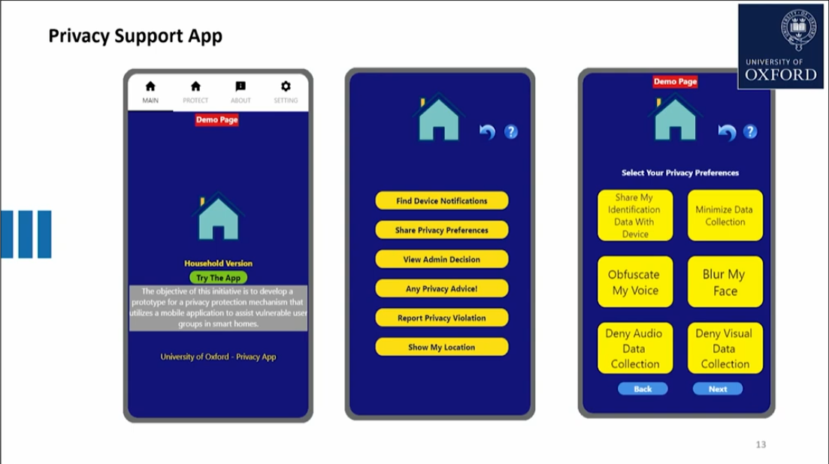
Paper Solution Overview
The original app proposed in the paper was not accessible.
We implemented a full-stack application that covers all core requirements.
The system simulates privacy modes and automated enforcement as a proof-of-concept.
Notes:
while original paper proposed a protection mechanism, this specific app was not implemented fully accessible. we bridged that gap by implementing a full-stack application that covers the requirements. Our system simulates privacy modes and automated enforcement as a proof-of-concept. The system we developed allows uers to select preferences like «Obfuscate My Voice» or «Blur My Face»

Slide 5
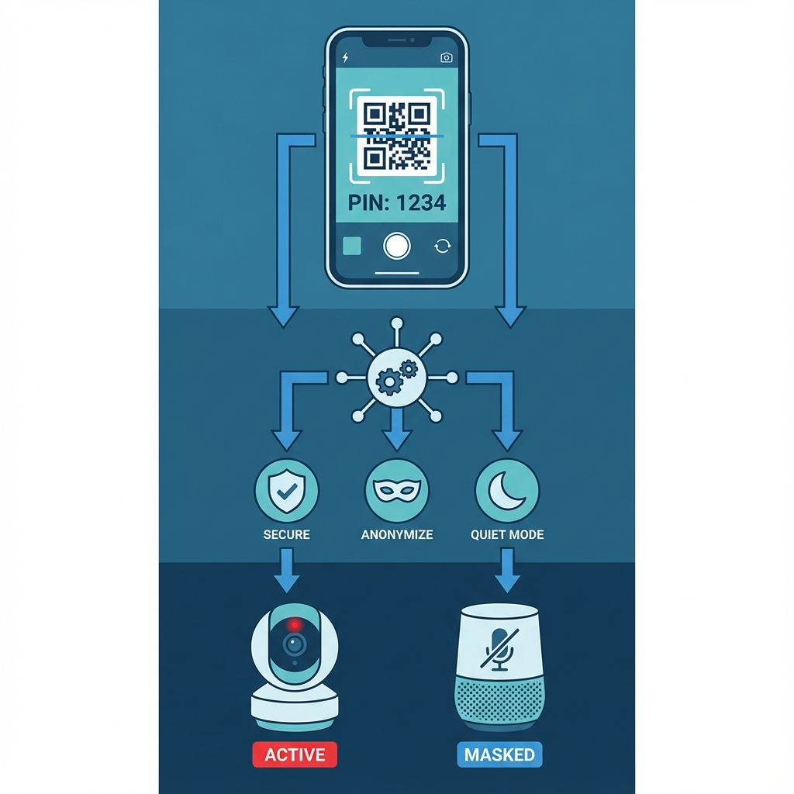
Our Solution Overview
Mobile-First PWA: Accessible via browser; no app store download required to lower the barrier for guests.
Zero-Config Authentication: Simple 4-digit home code (simulating a QR scan) for instant access.
Negotiated Privacy: Provides three pre-configured privacy modes to balance host security and guest comfort.
Automated Enforcement: Rules are applied instantly across the simulated device network.
Notes:
to lower the technical barrier for guests,we built a mobile-first progressive web app. there is no app store download required. you can simply browse the website and enter the home code te get Access. From there, the system enables «Negotiated Privacy» where modes like «Anonymize» or «Quiet Mode» are applied.

Slide 6
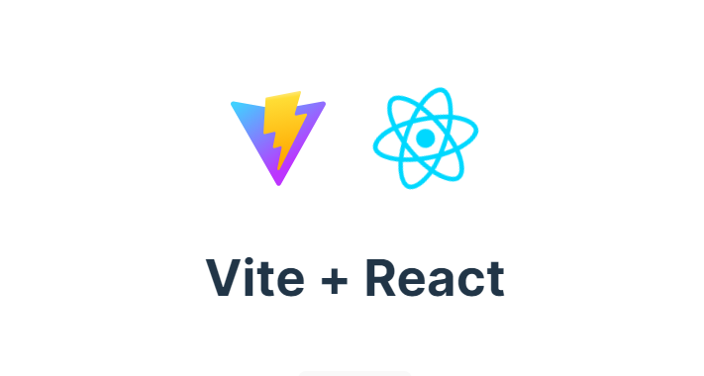


Technical Architecture
Frontend: React 18 + TypeScript + Vite for a high-performance, type-safe environment.
State Management: Zustand, a lightweight store used to manage real-time device states and UI themes.
Styling: Tailwind CSS v4 featuring a custom theme for Glassmorphism and mobile responsiveness.
Architecture: Feature-based folder structure to ensure code maintainability and scalability.
Notes:
For more technical detail, frontend is built with React 18, TypeScript and Vite for high performance. We used Zustand for real-time state management of device status. The UI uses Tailwind CSS that is fully responsive on mobile.
Express.js was used to run server on the background.

Slide 7
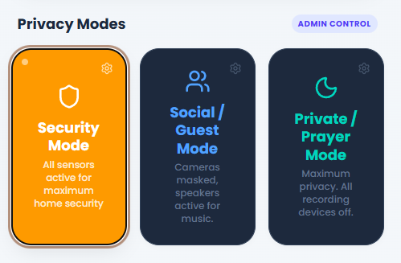
Privacy Modes (Core Feature)
Security Mode:
Priority on home protection. All sensors and cameras are active.
Notes:
There are three main modes in the app. First is Security mode. This is the default mode. All sensors and cameras are active for maximum protection.

Slide 8
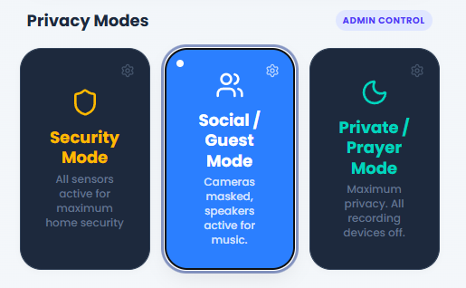
Privacy Modes (Core Feature)
Social/Guest Mode:
Optimized for conversation. Cameras are masked/covered, but smart speakers remain active for music or info.
Notes:
Social/Guest mode is optimized for conversations. Cameras are masked or covered but speakers stay active for things like music.

Slide 9
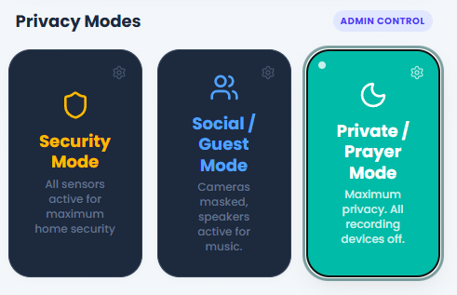
Privacy Modes (Core Feature)
Private/Prayer Mode:
Maximum privacy. ALL sensors disabled in specific rooms to accommodate cultural/religious needs (e.g., changing clothes or prayer).
Notes:
Private/prayer mode provides maximum privacy. all recording devices are turned off for cultural or religious needs, such as prayer or changing cloths.

Slide 10
Key Features
Device Transparency
Real-Time Inventory
All active smart devices are visible to the guest at all times.
Spatial Grouping
Devices are organized by room (Living Room, Kitchen, etc.) for better context.
Status Badges
Instant visual feedback via badges: Active, Masked, or Disabled.
Privacy Notices
Clear explanations of what data each device state collects (or stops collecting).
Notes:
as key features, we ensured device trancsperency through real-time inventory. Guests can see every smart device organized by room like kitchen, living room. We use status badges like active, masked or disabled to give instant visual feedback with explanationsof what data is being collected right now.

Slide 11
Smart Rule Engine
Logic Layer: Maps selected Privacy Modes to specific device hardware commands.
Automation Flow: 1. User selects mode (e.g., Social). 2. Engine identifies all cameras in common areas. 3. Engine triggers "Mask" state (simulated).
Immediate Feedback: UI updates status badges and icons globally across the app without refresh.
Notes:
the smart rule engine acts as the logic layer. whaen a user selects «social mode» the engine automatically identifies every camera in common areas and triggers a mask state. this happens globally across the app without needing a page refresh. this provides immidiate feedback to both host and guest.

Slide 12
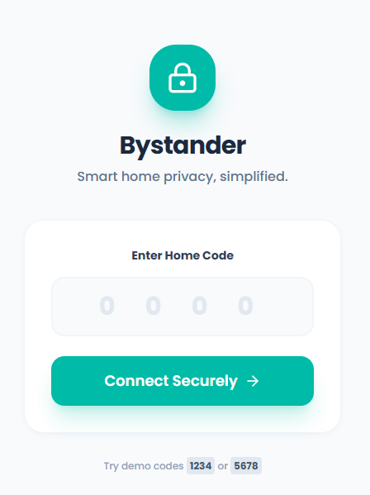
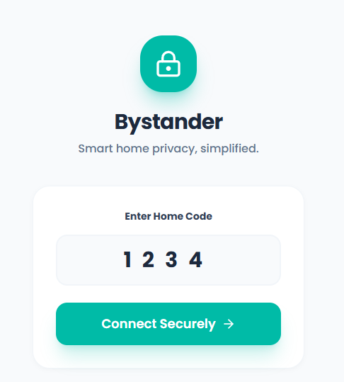
User Experience Flow
Entry: Guest and hosts enter the 4-digit code
Notes:
lets walk throug the user experience.
first entry. both host and guest connect securely using the home code.

Slide 13
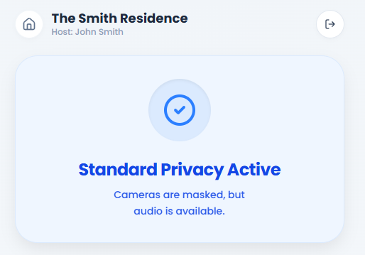
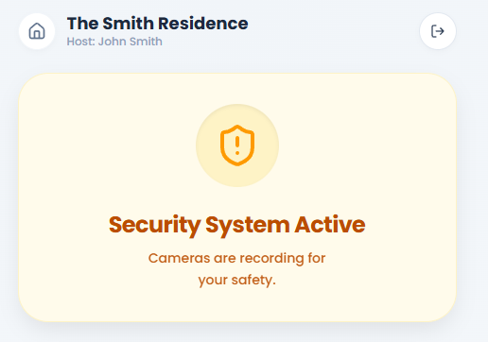
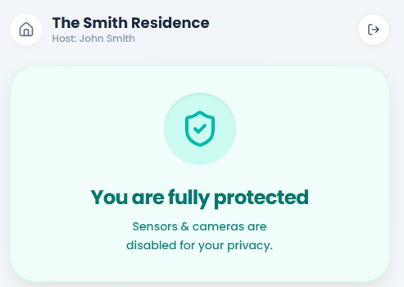
User Experience Flow
Guest Workflow
Viewing the Status of House
Notes:
the guest sees their current protection status, for example you are fully protected.

Slide 14
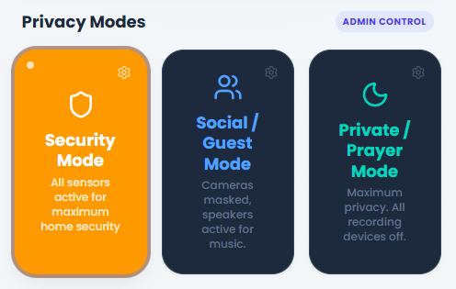
User Experience Flow
Host Workflow
Managing Modes (Security vs Social).

Slide 15
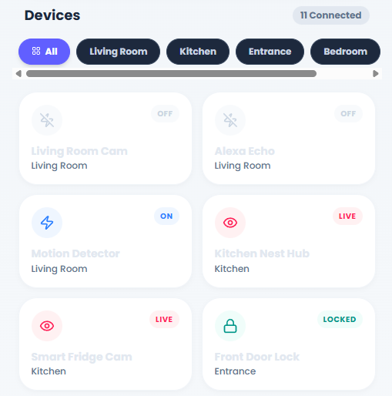
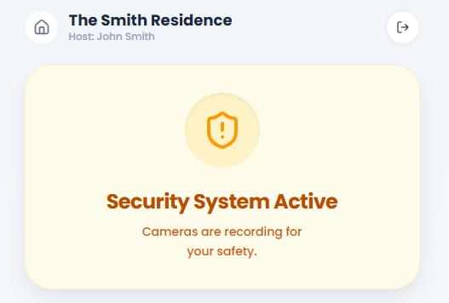
User Experience Flow
Guest Workflow
Viewing Status (Transparency).

Slide 16
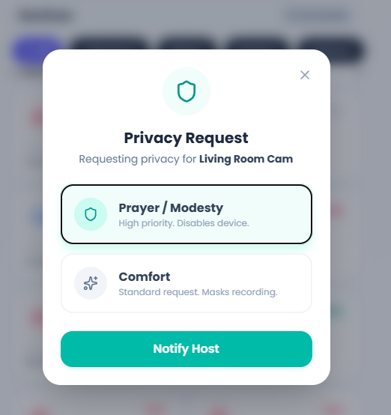
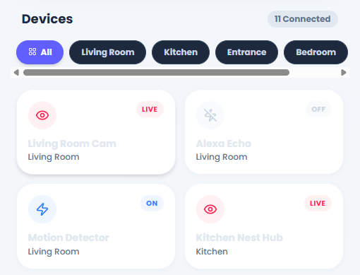
User Experience Flow
Guest Workflow
Negotiating Privacy (Requesting masking).

Slide 17
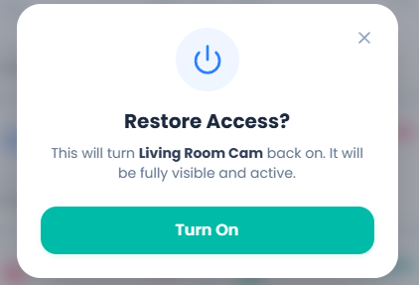
User Experience Flow
Guest Workflow
Restoring Access (Asking to turn on).

Slide 18
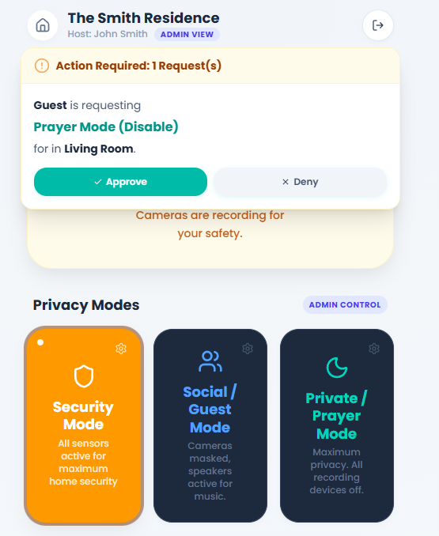
User Experience Flow
Host Workflow
Handling Guest Requests.

Slide 19
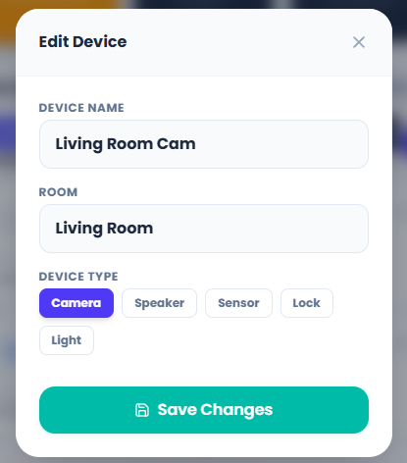
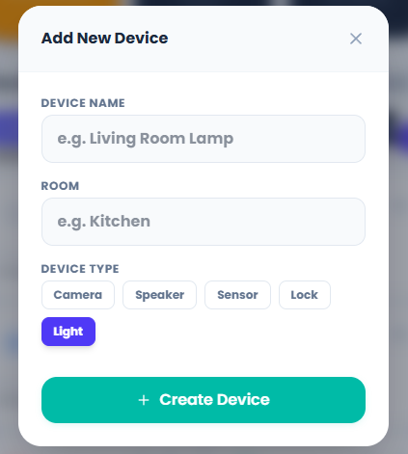
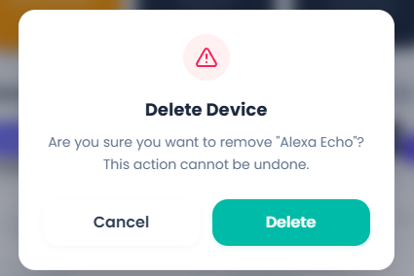
User Experience Flow
Host Workflow
Admin Tools (CRUD).
Notes:
for the hosehold owners, the app includes CRUD operations. hosts can easily add new devices, edit existing ones or remove old ones from the network with just a few taps.

Slide 20
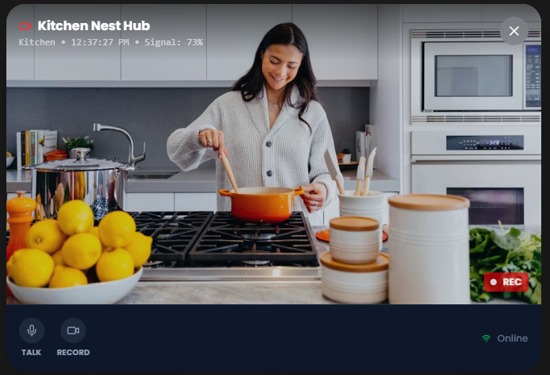
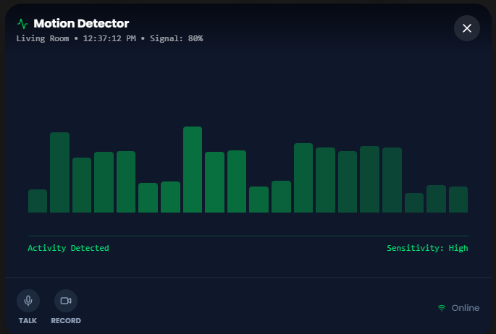
User Experience Flow
Host Workflow
Admin Tools (Live Feed).

Slide 21
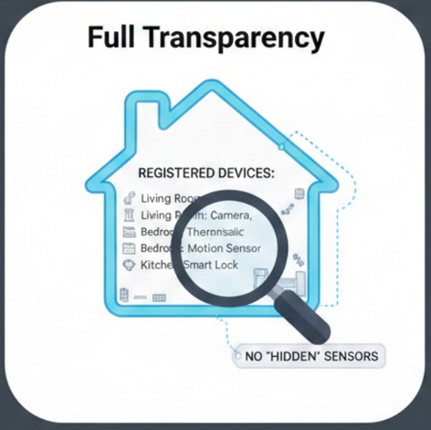
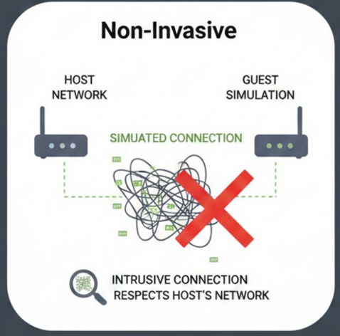
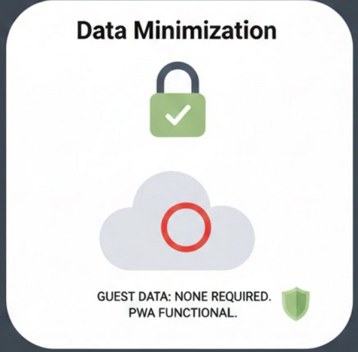
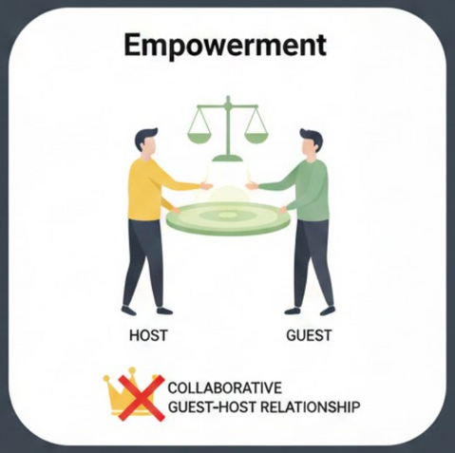
Security & Privacy
Considerations
Notes:
beyond functionality, we prioritize full transperancy. there are «no hidden sensors». every registered device is visible. we also practice data minimization, we require zero data from the guest to use this app. the entire connection is a non-invasive simulation that respects the host’s actual network while agreeing with guest on privacy.

Slide 22
Demo & Results
Environment: Live local demo UI available at http://localhost:5173 and server runs at http://localhost:3001
https://github.com/MalkocHasan/bystander-privacy-app
Test Scenarios:
Code 1234: Complex setup with multiple devices (Cameras, Speakers, Lights).
Code 5678: Minimalist setup with less devices.
Success Metric: Achieved 100% synchronization between mode selection and device status display.

Slide 23
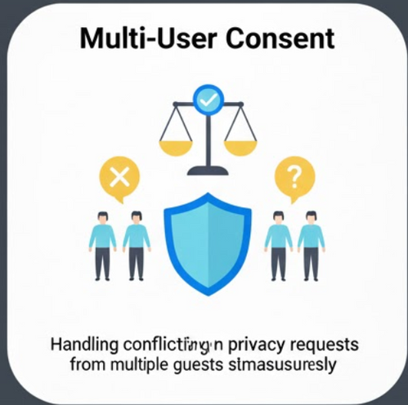
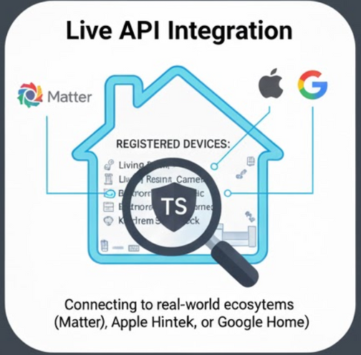
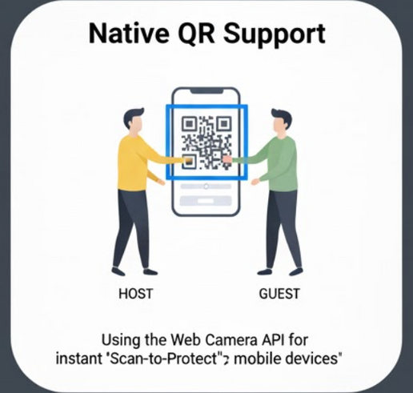
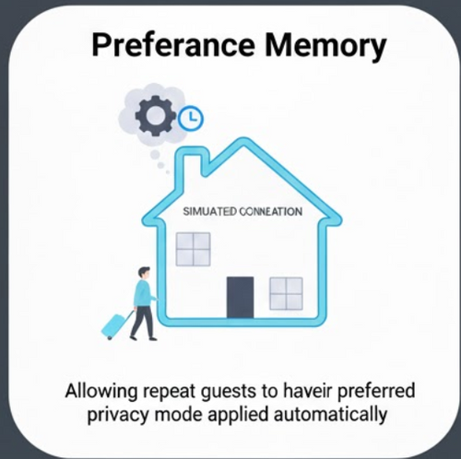
Future Enhancements
Integrating with Home Assistant and Matter protocols to control physical smart devices.
Handling Conflicting privacy requests from multipte guests simultaneously
Replace manual PIN entry with QR code scanning to authenticate guests.
Utilize ML to remember guest preferences, automatically applying their specific privacy settings.
Notes:
for future enhancements, we want to integrate a native QR support for even faster authentication. we are also exploring live API şntegration with protocols like Matter and Home Assistant to control physical hardware. we hope to use machine learning for preference memory so the app remembers and authomatically applies a guest’s privacy preferences upon their entry.

Slide 24
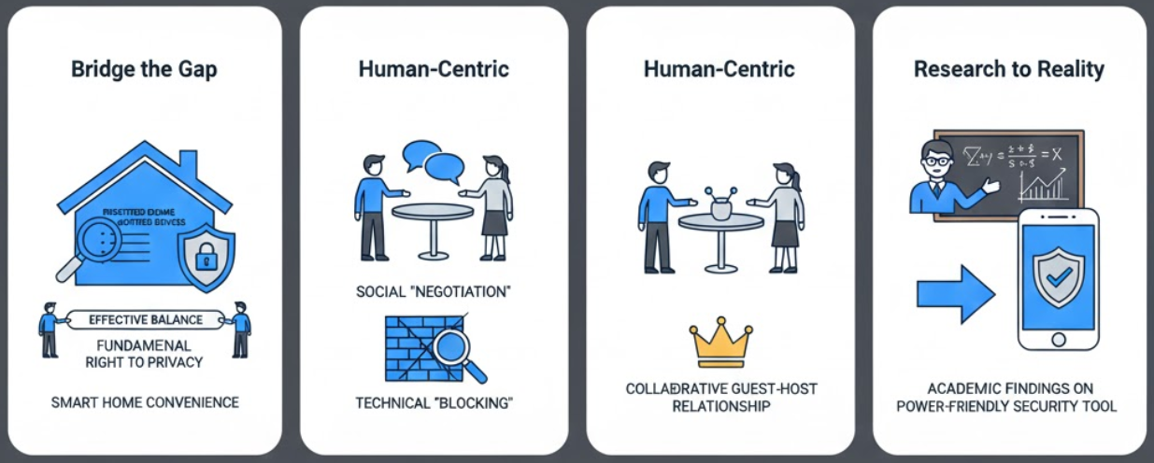
Conclusion
Notes:
In conclusion, our goal was to bridge the gap between academic research and daily reality. we want to transform the smart home from an «autocratic» environment into a «collabrative» one. By balancing convenience with the fundemental right to privacy, we can ensure technology serves everyone in the home.

Slide 25
Thank You
Any Questions?

